Slide 1
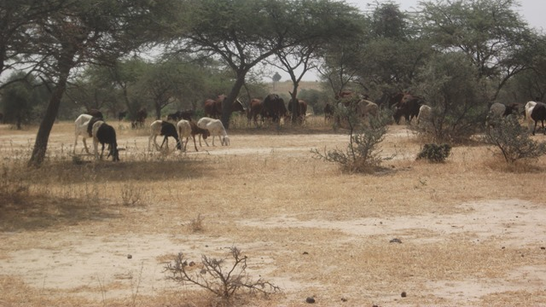
Safeguarding and good governance of the natural resources of the Tarka Valley in Niger
Copyright © 2012 Cooperative for Assistance and Relief Everywhere, Inc. (CARE)

Slide 2
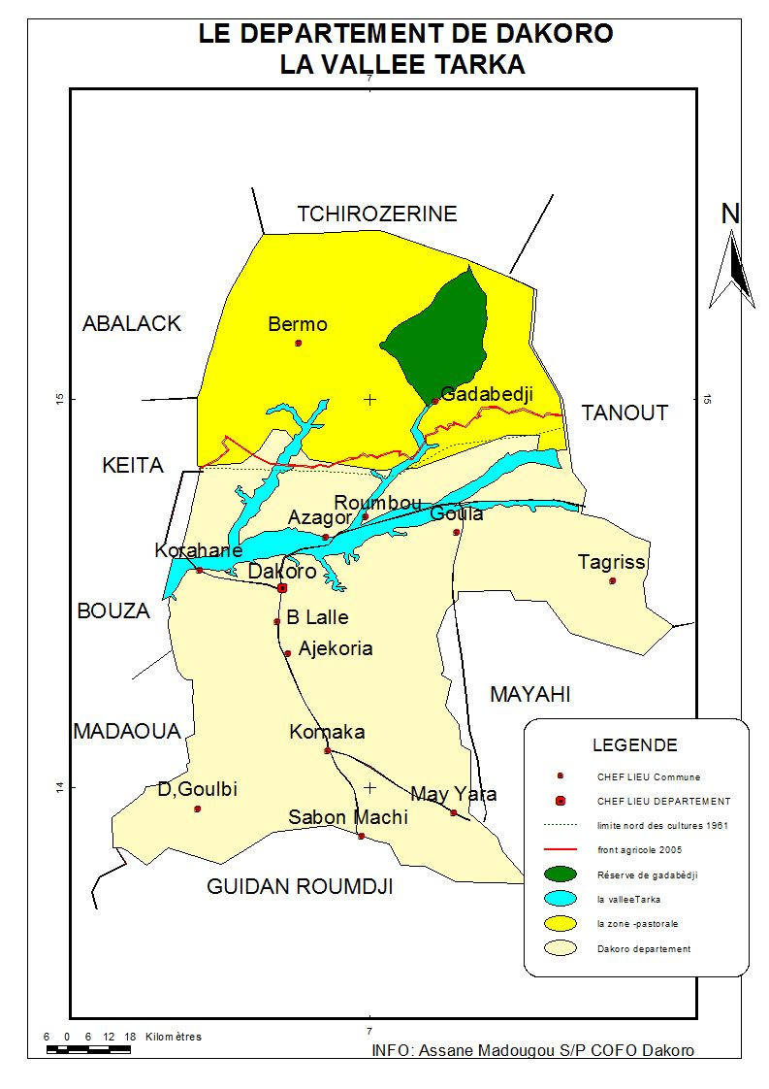
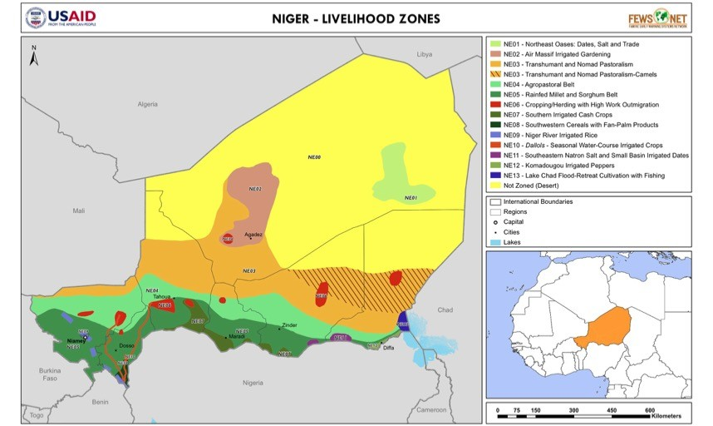
The Tarka valley
The current situation in the valley is an ecosystem in the process of degradation due to the effects of climate change, overgrazing and the northward advance of the agricultural front.
Notes:
The Middle Tarka Valley is located in Niger in the region of Maradi in the Dakoro department. More than 115 km long and 6 km wide.
Crosses the departments of Dakoro and Bermo from East to West in the agro-pastoral zone.
Originally, the Middle Tarka Valley was an enclave with essentially pastoralist use. Explain the Tarka Valley is the blue line in right side map, the bright yellow area is pure pastoralist and the sandy colour is agro-pastoralist (if that is correct?)
The Tarka Valley is a natural trail with a flat bottom where many herbaceous plants eaten by cattle grow. It is a strategic reserve with strong pastoral potential. This valley shelters and feeds the transhumant livestock of the Maradi region; part of Tahoua, Zinder, Agadez and Nigeria. However, it is currently undergoing a degradation of its ecosystems by uncontrolled actions of farmers and also pastoralists.
Dominant ecosystem and main source of communities for:
A fallback and dry season grazing area for pastoralist livestock.
Access to wood resources (timber, fuelwood, aerial fodder and utilitarian handicraft wood)
Water (the wells are the shallowest in the region with an average depth of 30 m compared to 50 to 80 m on the plateaux).
Fertile lands of the lowlands following the silting up of the traditional fields of the dune plateaus.
The Tarka Valley is coveted and disputed between communities for agricultural and pastoral production practices.
Droughts in the 1970s and 1980s caused the agricultural front to advance from south to north

Slide 3
Major challenges around the management of the valley
Climate change
Increase in population and livestock numbers
Competing livelihood groups and NR uses
Poor Agricultural practices
Decrease in water security
Decrease in soil fertility, increase in soil erosion
Decrease in availability of pasture
Land and forest degradation
Land Grabbing
Conflicts between users
Notes:
CES/DRS Soil and Water Conservation / Soil Defence and Restoration
The management of the natural resources is today facing difficulties in connection with:
Strong human and animal pressure in the winter season
Abusive and uncontrolled logging, bad SWC/SDR practices (by some actors)
Land grabbing in the valley by the wealthy for agricultural purposes and uncontrolled spread of crop fields
Conflicts between users, mainly transhumant pastoralists, indigenous people and farmers (disposing of trap fields) are becoming more and more critical and recurrent with often unfortunate consequences.
Climate change is leading to an increasing scarcity of fertile cropland and increasing difficulties of access to water and pasture for both traditional livestock and crop farming
Explain trap fields
Give examples of unfortunate consequences

Slide 4
Mechanisms in place for management and governance at the Tarka level
Natural Resources Management
National Rural Code (COFOB, COFOCOM)
Associations of users of the valley's resources
Departmental and communal services
Customary leaders
The management of the natural resources of the Tarka Valley is very complex.
It is not governed by specific regulatory texts, but rather by a social consensus (between all the users of the valley's resources) which has the force of law.
Notes:
The management of the Tarka Valley is carried out by the set of actors living in and around it. These are the autochthonous populations of the valley, in particular the pastoralists and agro-pastoralists, the transhumant pastoralists who have made this valley their home and where some of them spend most of their time in the winter season in search of pasture for their herds.
In addition to these, there are the state technical services, the structures of the rural code, the customary authorities, etc....
For Niger, the Rural Code is a set of texts that organize and govern the management of natural resources. It was established by Order No. 93-015 of 2 March 1993 establishing the guiding principles of the Rural Code, which lays down the legal framework for agricultural, forestry and pastoral activities with a view to land-use planning, environmental protection and human development. It ensures the security of rural operators by recognizing their rights and promotes development through rational organization of the rural world.
The basic land commission (COFOB) and the communal land commission (COFOCOM) are structures of the Rural Code located respectively at the village and commune levels and are chaired by the village chief and the mayor depending on the level.

Slide 5
A combination of governance factors added to climate change is causing the valley and its resources to degrade at an accelerated rate:
Text and Rules
No precise and clear rules and mechanisms for the management of the valley;
Implementation
Inclusiveness
Canton and group chiefs monopolize land to allocate it to their constituents under the pretext of demographic pressures;
No texts clarifying the status and vocation of the valley;
Lack of training and capacity of existing structures;
Political interventionism has made some users untouchable
No effective local structures of the rural code and/or their support structures
Lack of financial resources
The local natural resource management structures set up by local NGO projects no longer function (due to lack of resources)
Notes:
The combination of all these factors is causing the valley and its resources to degrade at an accelerated rate. This situation calls for urgent action to secure and develop the valley in order to preserve what remains of the valley for the well-being of all users.
Safeguarding and good governance of the valley's natural resources are at the heart of the resilience of the living systems of the vulnerable households living there.

Slide 6
Ensuring the security of the Tarka valley and its resources
The process of securing the Tarka Valley is now supported by technical and financial partners with the consent and full participation of the administrative and customary authorities as well as all professional social strata in and around the valley.
Process to date:
Baseline study on protection of the Tarka valley recognizing land and resource use rights.
Map of the current natural resources of the Valley; with analysis of the evolution of the valley's resources through satellite images.
Elaboration of a Land Development Plan for Maradi region
Regional actions to mark out livestock corridors and limit the encroachment of crop fields.
Notes:
As a prelude to acting on securing the Valley, the proposals for prior actions to be carried out are as follows:
The completion of the implementation of the Cofob at the level of villages and tribes of the valley;
The reinforcement of the capacities of the Cofob set up on the procedures for securing shared resources;
Recycling of existing structures (Cofob, Cofocom, Cofodep) on procedures for securing shared resources;
The equipment of the structures of the rural code of the zone set up;
The construction of a headquarters for the Dakoro departmental land commission.
The establishment of a multi-stakeholder consultation framework to support and accompany the structures of the Rural Code in the conduct of security in the interests of legitimacy.
Registration of the valley and the secured resources in the Rural File
Periodic control of the development of the valley and these resources by the structures of the Rural Code

Slide 7
Thank you for your attention
Copyright © 2012 Cooperative for Assistance and Relief Everywhere, Inc. (CARE)

